Slide 1




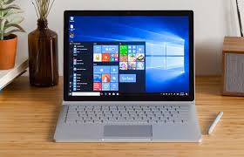
FLOWCHART
START
FINISH

